Slide 1

Missiological Urban Research
TUL540-10
Viv Grigg, 2019

Slide 2
Missiological Urban Research: Peoples of the Cities - Cities of the Peoples
Cities have many veins of gold. They run in many directions and need to be searched for.
The aim of missiological research is the formation of Kingdom communities that engage with needs and transform the city to live under the goodness of His reign.
There are several ways of viewing the city to find that gold, to find the responsive peoples. We can map these as overlays
Supplementary Readings: People Groups in Cities
Greenway, Roger and Timothy Monsma
1989 "The Intersecting Veins of the City". In Cities: Missions New Frontiers, Baker.
Conn, Harvey
1991 " Unreached Peoples and the City". Urban Mission, Vol. 8, No. 5, May 1991.
Structures
Linkages
Ethnic Groups
Occupational Groups

Slide 3
The Ancient Practice of Discernment of the City
Listen to God's heart for your city
Nehemiah prayed, fasted and wept for his city. From this a vision was born. In Jerusalem, Nehemiah inspected the walls of the city and developed the vision into a workable plan - we need to know where the ruins are. Prior to bringing people together some initial understanding of God's purposes and plans and some initial research is essential to be able to give a framework for discussion.
You know how to interpret the appearance of the sky, but you cannot interpret the signs of the times. (Matthew 16:3)
Along with the intervention and activity of God as he breaks into a city, is a very human component, a response, a listening. The scriptures command us again and again to "Hear, and obey." Hearing is not only a spiritual activity. Any cursory reading of the prophets shows how it involves fine application of the mind to the issues of the day along with the direct spiritual revelation from God.

Slide 4
The Ancient Practice of Discernment of the City
Listen to the winds of the Spirit
We need one ear to the ground and another pointed to heaven. What is God doing in the city? This we hear as we sit down and begin to listen to the stories of the other Christian leaders and of the church planters. This is the reason for story-telling consultations. When God breaks out in one quarter of the city with something new, how rapidly can this be conveyed to the other leaders of the city?
Listen to the cries of your city
Hearing the cries of your city begins with involvement with the agonies of the poor. It involves the quiet listening to the heartbeat and cries of its people and leaders. Jesus did this when he went preaching. He did it as he sought out lost sheep, prostitutes, little men climbing trees or bewildered leaders in government.

Slide 5
The Ancient Practice of Discernment of the City
Listen to the lessons of history
How did the church grow in the city? What have been the key covenant events or environmental factors that have effected the spiritual life of the city? Understanding these issues may identify some of the points of repentance needed as a people in the city. History predicts prophecy. The past gives the clues to the future. Compiling this information into a small booklet will make this information available to others in the same journey.
You know how to interpret the appearance of the sky, but you cannot interpret the signs of the times. (Matthew 16:3)

Slide 6
Beware! The Achilles Heel of Western Academics
After 30 years of learning language and culture, then,
He did not survey
He sent his 12 then 70 out preaching. This was his surveying.
Where there was a response, there they paused.
So what is the place of research?
Forever preparing
Never acting

Slide 7
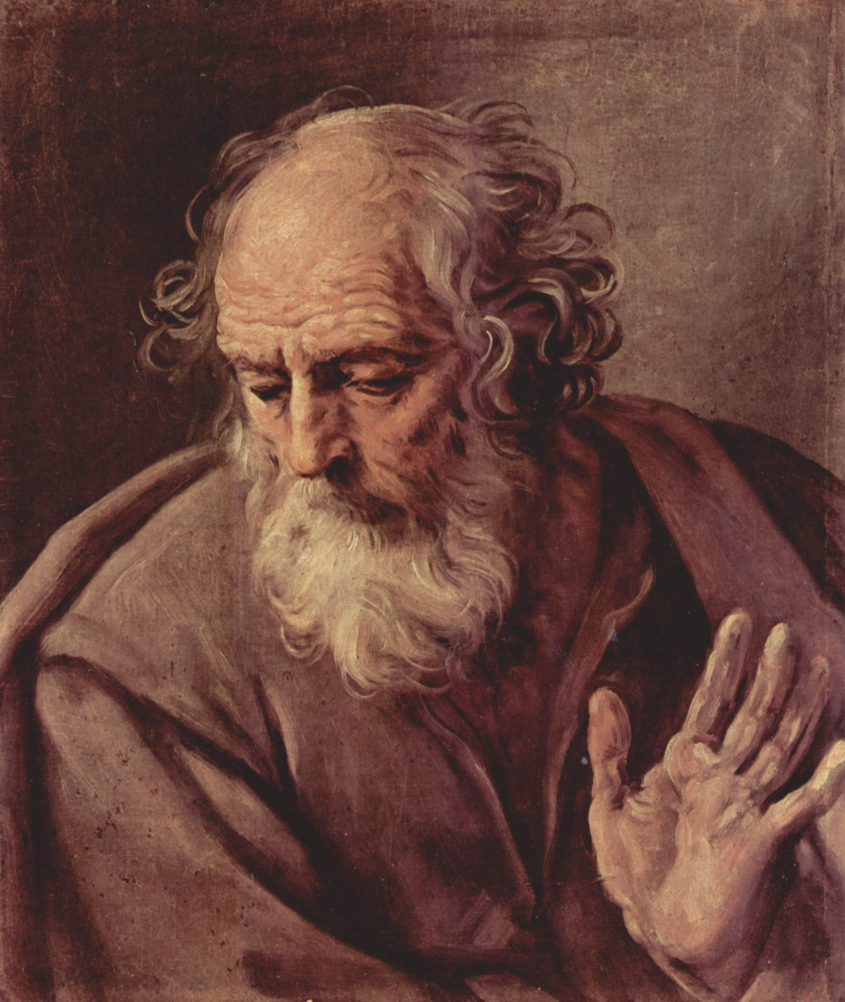
The Biblical Basis for Research
Moses prepared the ground for taking many cities. He had the instructions from God as to the objectives. His was the human task to flesh out the framework for battle. He sent advance scouts to spy out the land.
In Numbers 13:26-33 ten spies brought an unfavorable report, interpreting the data without faith, two spoke with faith, interpreting the data in terms of God's perspectives.

Slide 8
The Biblical Basis for Research
God blesses the accumulation of accurate data (truth), that relates to his purposes, and interpretations of that data in the light of his nature. Part of his purposes are that we fully tell good news to the world.
Accurate information is also a foundation for prayer. In Ezekiel 4:1,2 we find a process of mapping a city for purpose of focusing prayer on that city:
Now son of man, take a clay tablet, put it in front of you and draw the city of Jerusalem on it. Then lay siegeworks against it...

Slide 9

Why Research?
Decision-Making: Research is not for the sake of amassing data. Research is about providing the right data to make reasonable decisions. For evangelism we need to know who?, where?, how? We need to discover the needs of the poor. For transformation of city structures and culture we need to know who are the key people?, what are the structural evils and issues? when is appropriate timing for changes?
Prayer
Prayer
Prayer
Prayer
We mobilized 10,000 to pray for Kolkata one month. That month marked the turning point from 1 new churches in 40 years to over 700 new ones. The prayer was based on some years of developing people group research on 83 groups in the city.

Slide 10
Why Research?
Unity through Strategy: It can involve more than this. Presentation of research on the harvest force (the church) and the harvest field (the language groups [people groups], castes, classes etc.) of the city, is a very powerful tool for bringing together city leaders :
* all will have a component interest
* Where there is a non-threatening basis for shared discussion of ongoing strategies
* It focuses peoples thinking beyond present interests to the broader picture
Resource Management: Strategic statistical research should only be used as a supplement. There should not be too much and it should not be too detailed, or resources will be wasted.
Prayer
Prayer
Prayer
Prayer

Slide 11
The Research Network
The Research Gathering that feeds into the City Leaders Consultation
  Prior to a city-wide strategy gathering, the researchers need 18 months to a year to bring together the research which becomes basic to the discussions.
Bringing together the researchers from various Christian organizations in the city is a wonderful and amazingly complex task. Each has an agenda, so finding commonality is not always easy. Each has a research approach. But if this is successful, it can be a significant basis for generating unity.

Slide 12
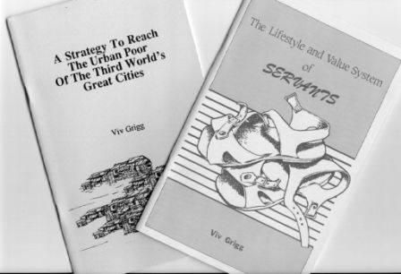
Research Publications
The end result of all this, could be 5 small booklets for a dollar or two a piece to move leadership forward in your city.
  1. a church directory
  2. a booklet of case studies from church-planters
  3. a short history of the city
  4. mapping of the churches in the city and the ethnic groups and socio-economic communities, with some analysis as to how this predicts the growth of the church in the city
  5. networking diagrams of church networks, social work networks, women's networks, businessmen's networks etc...
More significant books are likely to develop from those who are trained in academics and are part of the Seminaries or are funded by businessmen.

Slide 13
Multiple Foci of Urban Research: The City as an Organism of Morphing Structures
Political Leaders
  Pull up Photos
  Diagram the connections
  Who are the Leaders of Peace?
Geography
  of rivers and sewerage lines defines the high and low lands, and the location of rich and poor.
  Chaos theory predicts where expansions will occur
  Follow the rivers to find the slums
Academic Structures
  Where is the flow of ideas?
  Who are the idea-makers?
  Who are the change-makers? The insider – innovators?
Cities are based on structures. They cannot function apart from the structures of sewerage systems, electrical systems, roading systems. Yet they have a constantly evolving life. They are dependent on each other, and find some unity together, but these dependencies and unity are constantly changing. They are interdependent.

Slide 14
Multiple Foci of Urban Research: The City as an Organism of Morphing Structures
Political Leaders
  Pull up Photos
  Diagram the connections
  Who are the Leaders of Peace?
Geography
  of rivers and sewerage lines defines the high and low lands, and the location of rich and poor.
  Chaos theory predicts where expansions will occur
  Follow the rivers to find the slums
Academic Structures
  Where is the flow of ideas?
  Who are the idea-makers?
  Who are the change-makers? The insider – innovators?
Cities are based on structures. They cannot function apart from the structures of sewerage systems, electrical systems, roading systems. Yet they have a constantly evolving life. They are dependent on each other, and find some unity together, but these dependencies and unity are constantly changing. They are interdependent.

Slide 15
Maps and Statistical Research
1. Harvest Force: Mapping the Church in the City
·Locate the churches in the city and the inter-church organizations on a large piece of plastic laid over the city map and place at back of the room
· Pass out listing of churches, addresses and pastors for verification by the pastors (number of members and language groups should be included in the survey)
· Discuss idea of selling this as a directory and getting advertising.
· Diagram the networks between these churches, identifying key nodes, centers of each network. If possible do this by different color. Many of the networks will be denominational
Statistical analysis of the growth of the church can be used as a basis for projections

Slide 16
2. Ethnic Peoples
The Concept of People Group
  What is an Unreached People Group?
Case Study: Calcutta, City of Joy
  The 11.9 million people include 83 major languages of over 10,000 people.
  There are 56 different types of Muslim in Kolkata

Slide 17
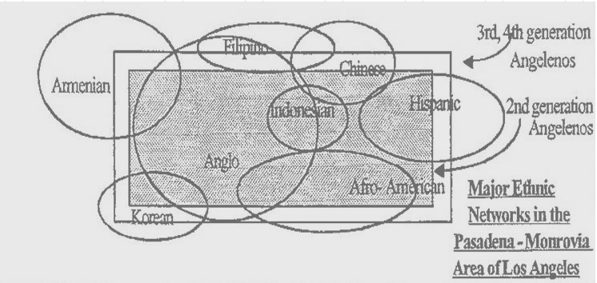
Harvest Fields:
Overlay 1: Identifying Ethnic Groups
· On hyour map, overlay a diagram of language groupings in the city on plastic on the charts
· Which are responsive?
· Which have a church?
Discuss the idea of a booklet of people group profiles for these groups that show their background and possible ways they could be reached.
  These would develop one to two pages on each group, on defining who , how many, issues of penetration, group formation, leadership emergence, cultural keys, who have initiated ministries, what is working, etc.
In Calcutta this resulted in a 150 page document covering 85 minority groups within the city. There are another 85 major languages that have yet to be done.

Slide 18
The Maori as Case Study of a People Movement
Multi-Cellular People’s Movement
The first spiritual movement along the Hokianga, beginning with a group of 5.
In 1835, some 200 could answer the catechism.
By 1836, the missionaries printing press was at work and had reached the gospel of John. That year a chief plus 120 people.
Later that year 130.
By the end of the year 1500.
The New Testament had been printed.
In 10 years 20,000 had converted.
There were 21 mission stations with 31 missionaries, 440 indigenous teachers, 113 indigenous schools, and 7027 communicants.
Both movements began in chiefly circles. As slaves were freed, they travelled back preaching.
Tippett, Alan. People Movements in Southern Polynesia,
a. Base Structure
The Maori in New Zealand came to Christ through two movements: Anglican and Methodist. Both had the resources to sustain teams of about 30 missionaries over 30 years.
b. Invitation
In 1809 a massacre . The shame of this resulted in 1814 invitation to Marsden. He preached his first message and won their hearts After time the chiefs gave permission to go inland. He submitted to a tribal welcome, understood their worldview, and answered their questions. He trusted the chiefs with the work.
c. Research
d. Scripture Translation
e. Teaching Literacy

Slide 19
3. Harvest Fields: Network Analysis
Examine the concept by discussing how politicians relate to politicians, and how teachers relate to teachers, etc.
  What are the bridges within these groups? (the links)
Have a group list other networks.
  Are there ministries to these? (Usually inter-church ministries).
List the 20 or 30 people who hold the power to determine the direction of the city.
  Analyze what Christian leaders are in relationship to each of these.
This is a new field of research, that can get very complex with computer analysis.
Example: Today I researched politicians in my country: Where do they study? What links to they have to which sectors of the community? which are thinkers? Which have some ethical basis to their decisions? Who has some Christian heritage? What are the links between them?

Slide 20
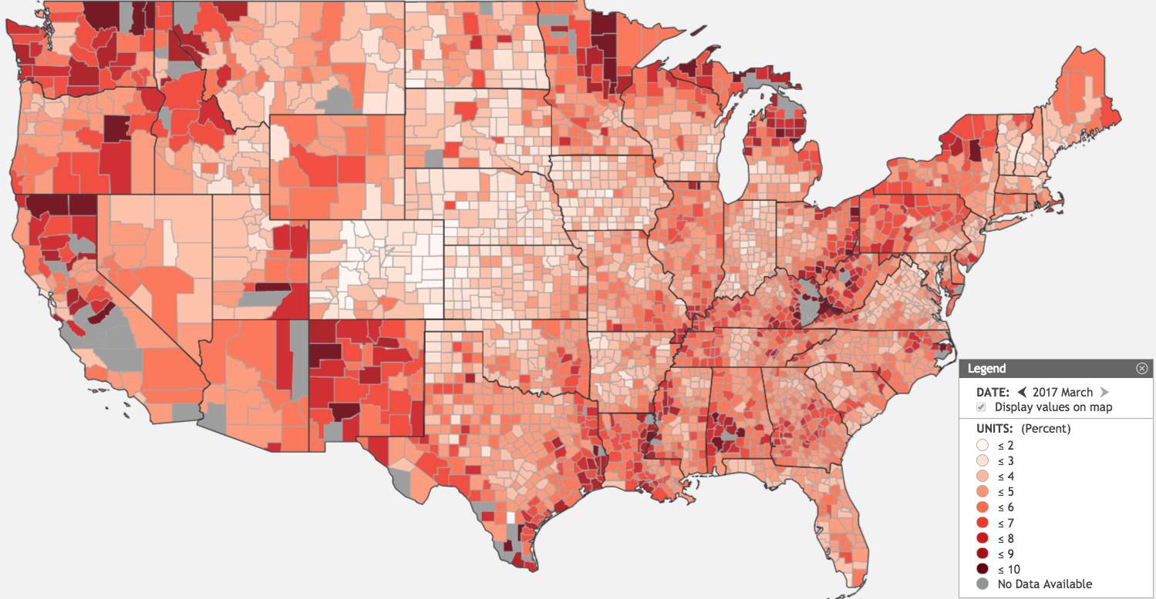
4. Harvest Fields: Looking at Socio-Economic Groups in the City
Who are the rich? Discuss Jesus reaching the elites. Social transformation occurs from the top down. Is this happening? If not, why not?
· Are there students? What ministries exist to them?
· Who are the poor? Church growth occurs form the bottom up. Who are reaching the prisoners? the slaves? the street children? Expand Luke 4:18-20.
· Are there special classes that are separated off from others not by language but by some other social factor?
· Do these have churches? Are there "bridges" to them?
· Discuss writing 2 page profiles on each of these and proposals for reaching each group.
Unemployment in the United States

Slide 21
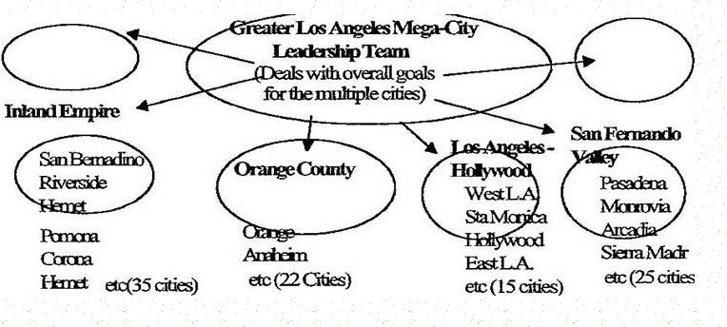
4. Harvest Force:
Overlay 3:Looking at Cities within Cities
· List all the cities or mark them on an overlay
· Are there city networks or city coordinators for each one?
· Are there natural groupings of cities that work together?

Slide 22
5. History Predicts Responsiveness: What groups responded in the past? Why? What Churches Were Planted When?
When doing the pre-conference survey find the starting date of the churches. Graph these onto an overhead, finding out in which years there were major new numbers of ministries. Why?
· Discuss the idea of someone writing a booklet of 30 historical case studies from the history of the churches (one page each, with principle at the bottom of each page). Who planted what when and how did it grow? What worked?
· Which churches have grown and how?
· Have case studies presented and reflection on the principles they highlight
· Discuss the idea of a booklet of 30 present day case studies, one page each, with a principle at the bottom of the page.

Slide 23
6. What to Look For In Doing Transformational Urban Analysis
1. Who determines the direction of each sector?
2. Who advises them and how?
3. What are the ethical issues of the day? How can they be publically addressed?
4. How does one move from ethics to effective evang cells in this sector of the city?
· Communities in the city where transformation has taken place
· Ranking of perceived needs in the city or in sectors of the city
Level of Christianity in the society (% Christian, % church attendance)
· Levels of penetration, points of contact with the elites
· Structures of the City: Analysis by groups of Christian leaders in the city of how the Kingdom of God is and could impact systems in the city.
  the educational systems
  o political, civic and urban planning systems
  o law
  o ethnic, racial and minorities issues
  o health, dental and medical systems
  o the arts
  o the banking, and business sector etc.

Slide 24
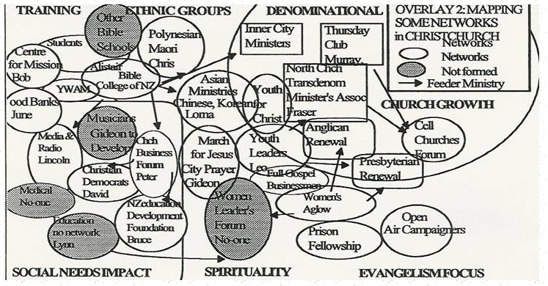
7. Citywide Networks
Who are the appointed religious leaders in the churches?
· Who are the apostolic, prophetic and evangelistic leaders?
· To what extent are they functioning in unity? (see earlier worksheets).
· The simplest way to do this in any ministry is a large sheet of cardboard and a networking diagram (see illustration ).
Nodes: What are the key groupings of pastors in the city? Draw them in. Write the name of the leader of each. Put those that have similar values near to each other.
  For example in Los Angeles we divided the page into four quarters representing evangelistic networks, social service networks, prayer networks and pastors networks.
Linkages: Some networks cross between the quarters. Draw in connecting lines to show the relationships between these leaders. Draw in arrows that show some ministries that feed people or leaders into other networks.

Slide 25
Christian City Networks: Christchurch as an example

Slide 26
Sample Worksheet: Strategy Map of the City
Mapping Exercise
As part of or in preparation for the pre-consultation or City Strategy Congress this exercise will help to break down the city into reachable communities:
1. Trace onto the cardboard the map of your city (or the map could be done on an overhead and in black and white xeroxable format. For cities under 100,000 it could be done by hand. For larger cities consider a computer program such as Supermap or some other mapping program )
2. Place name of city and state at top right. Write down the city and metro-city populations
4. Draw in the main arteries, railway lines, highways, rivers
5. Draw an overlay of geographic boundaries, possibly political (usually the easiest in terms of available data) or their may be more natural breaks
6. Draw in areas where the rich live (use a legend in lower right corner)
7. Draw in areas where the poor live. Who are they?
8. Put % of the population that are slums or the number of bustees on right corner.
9. Put down the main religions and their percentages in the right.
10. Put down the main languages and their % at the top right hand corner. Draw an overlay with location of the language groupings in the city. Which of them have a church?
11. Plot in the churches in the city (Use a different color for Roman Catholic,, Mainline and Pentecostal, sum the total number of churches on the right by the legends.
12. Plot in areas where main religious groups live (on the map or as an overlay).
13. An overlay based on city planning projections as to where new communities will be developed.
Prior to the Research Consultation attempt to find the following data:
1. Name of city and state
2. Population
3. No. of Churches in city - Roman Catholic, Orthodox, Mainline, Pentecostals, etc.
4 .Christian Population (census), Christians attending churches, Church / population ratio
5. % attending churches , % Christian in city compared with national percentage
6. Growth and decline in overall church attendance over a 20 year period
7. A general description on the nature of the churches of the city, particularly those that have grown, and some indications as to why this might be.
8. Languages in city? Worship in which languages?
9. Is there a prayer movement?
10. Who are the recognized leaders? (spiritually).

Slide 27
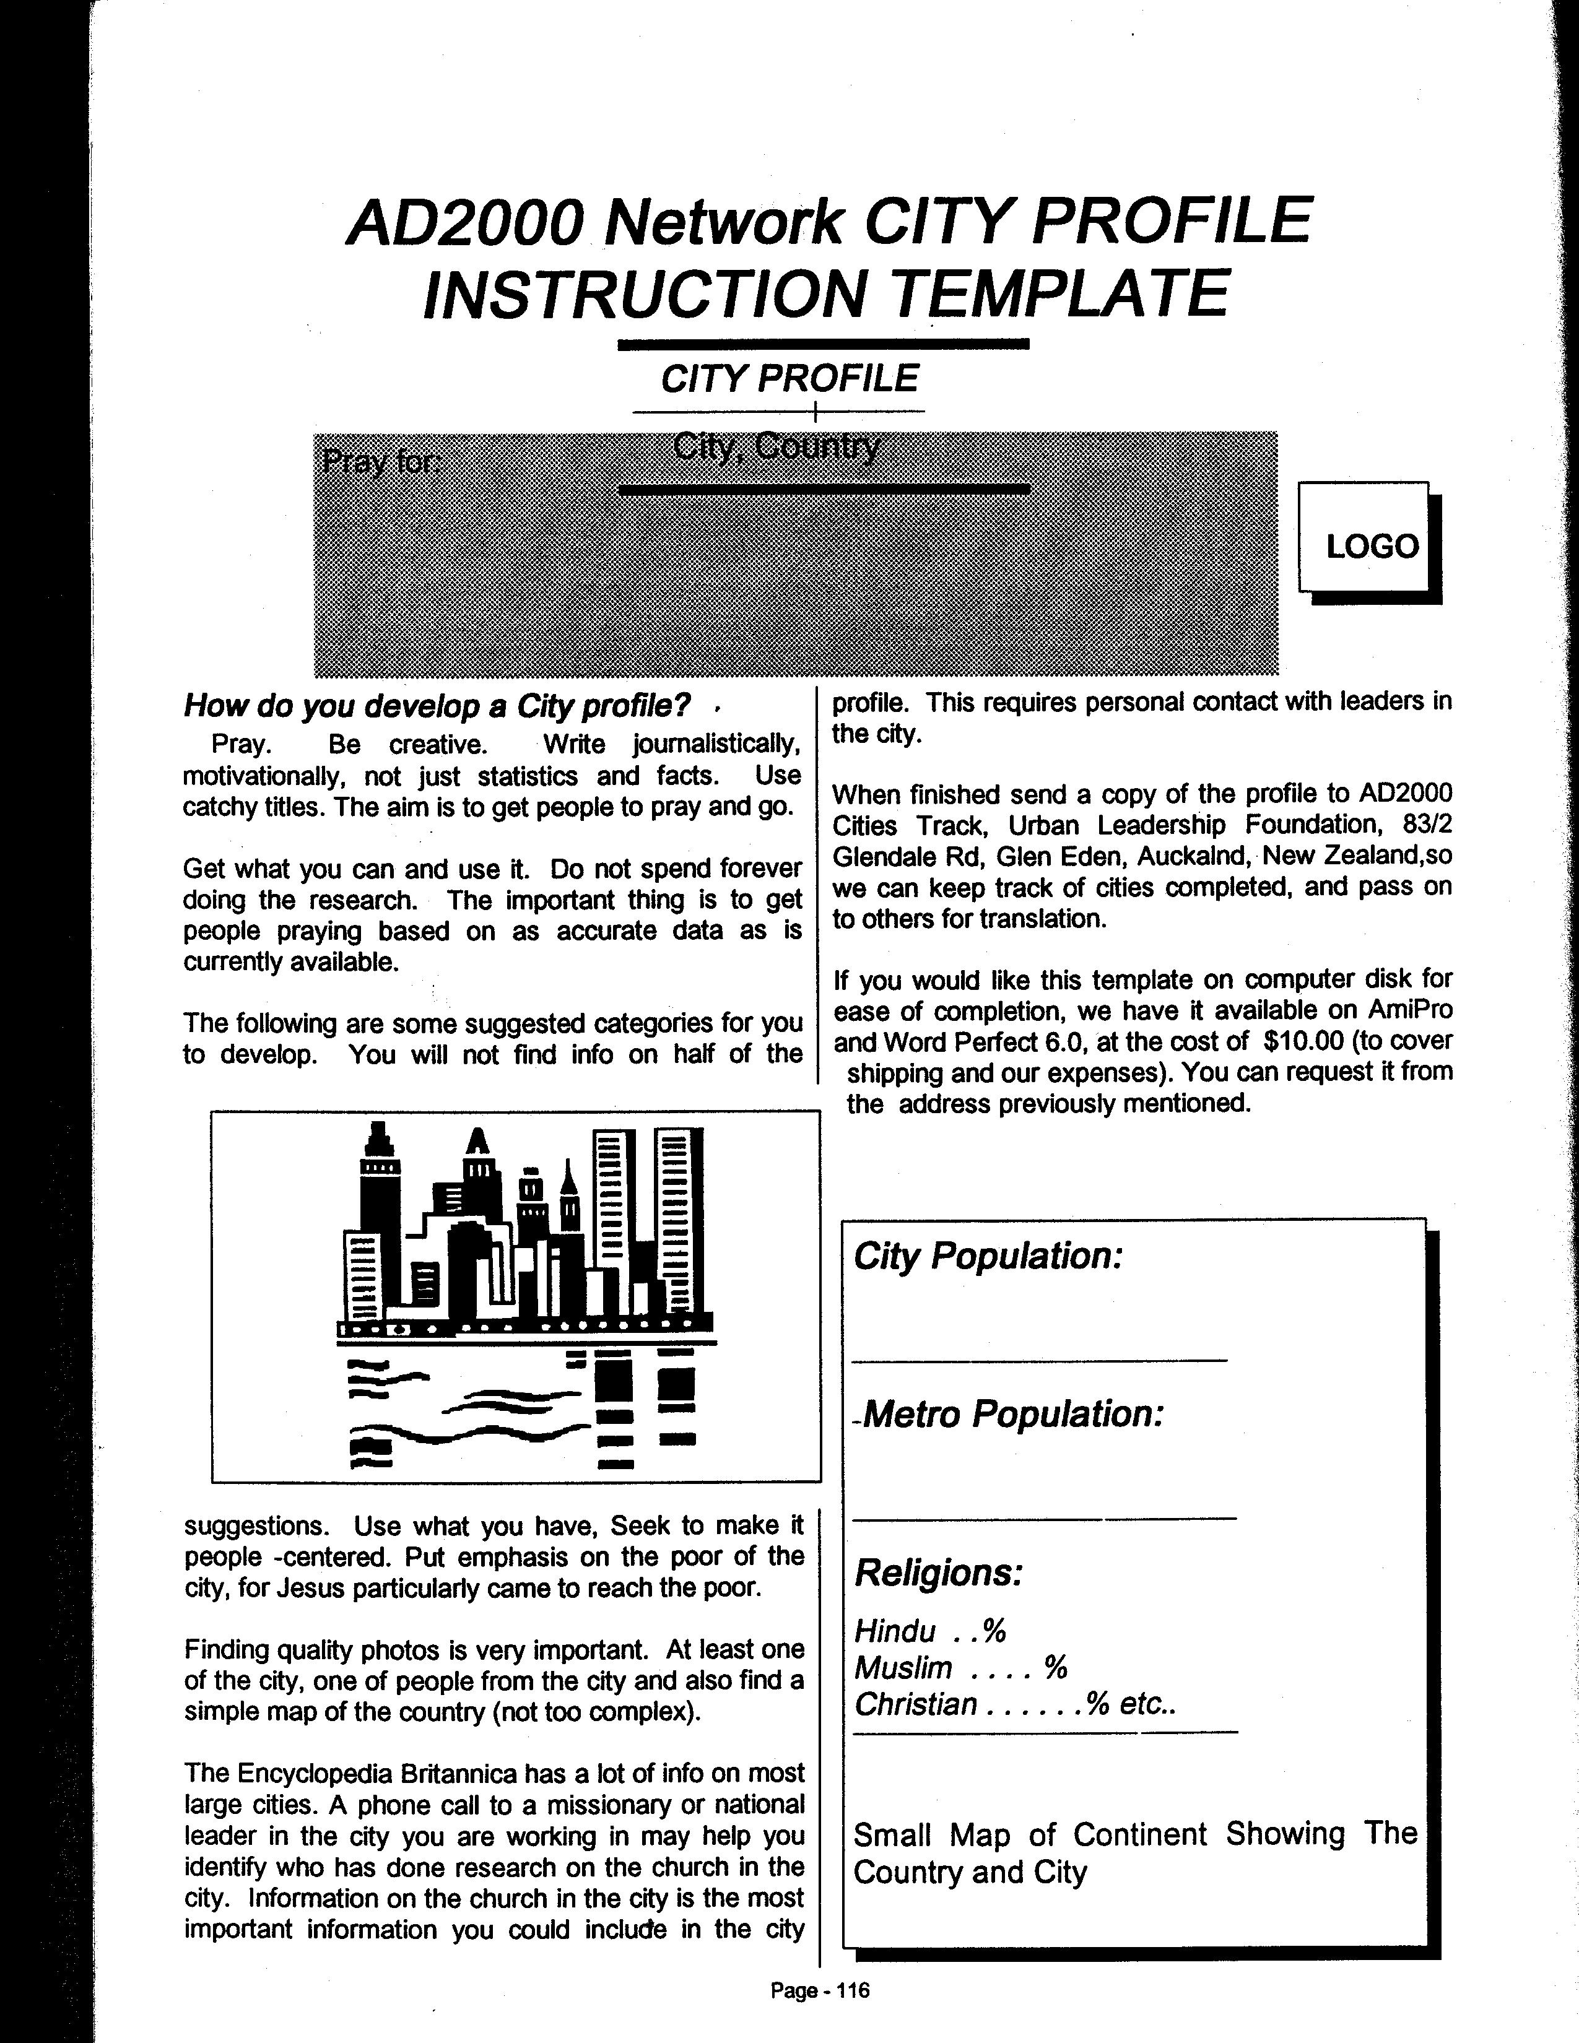
Case Study: City Profiles as a Basis for Raising Prayer

Slide 28
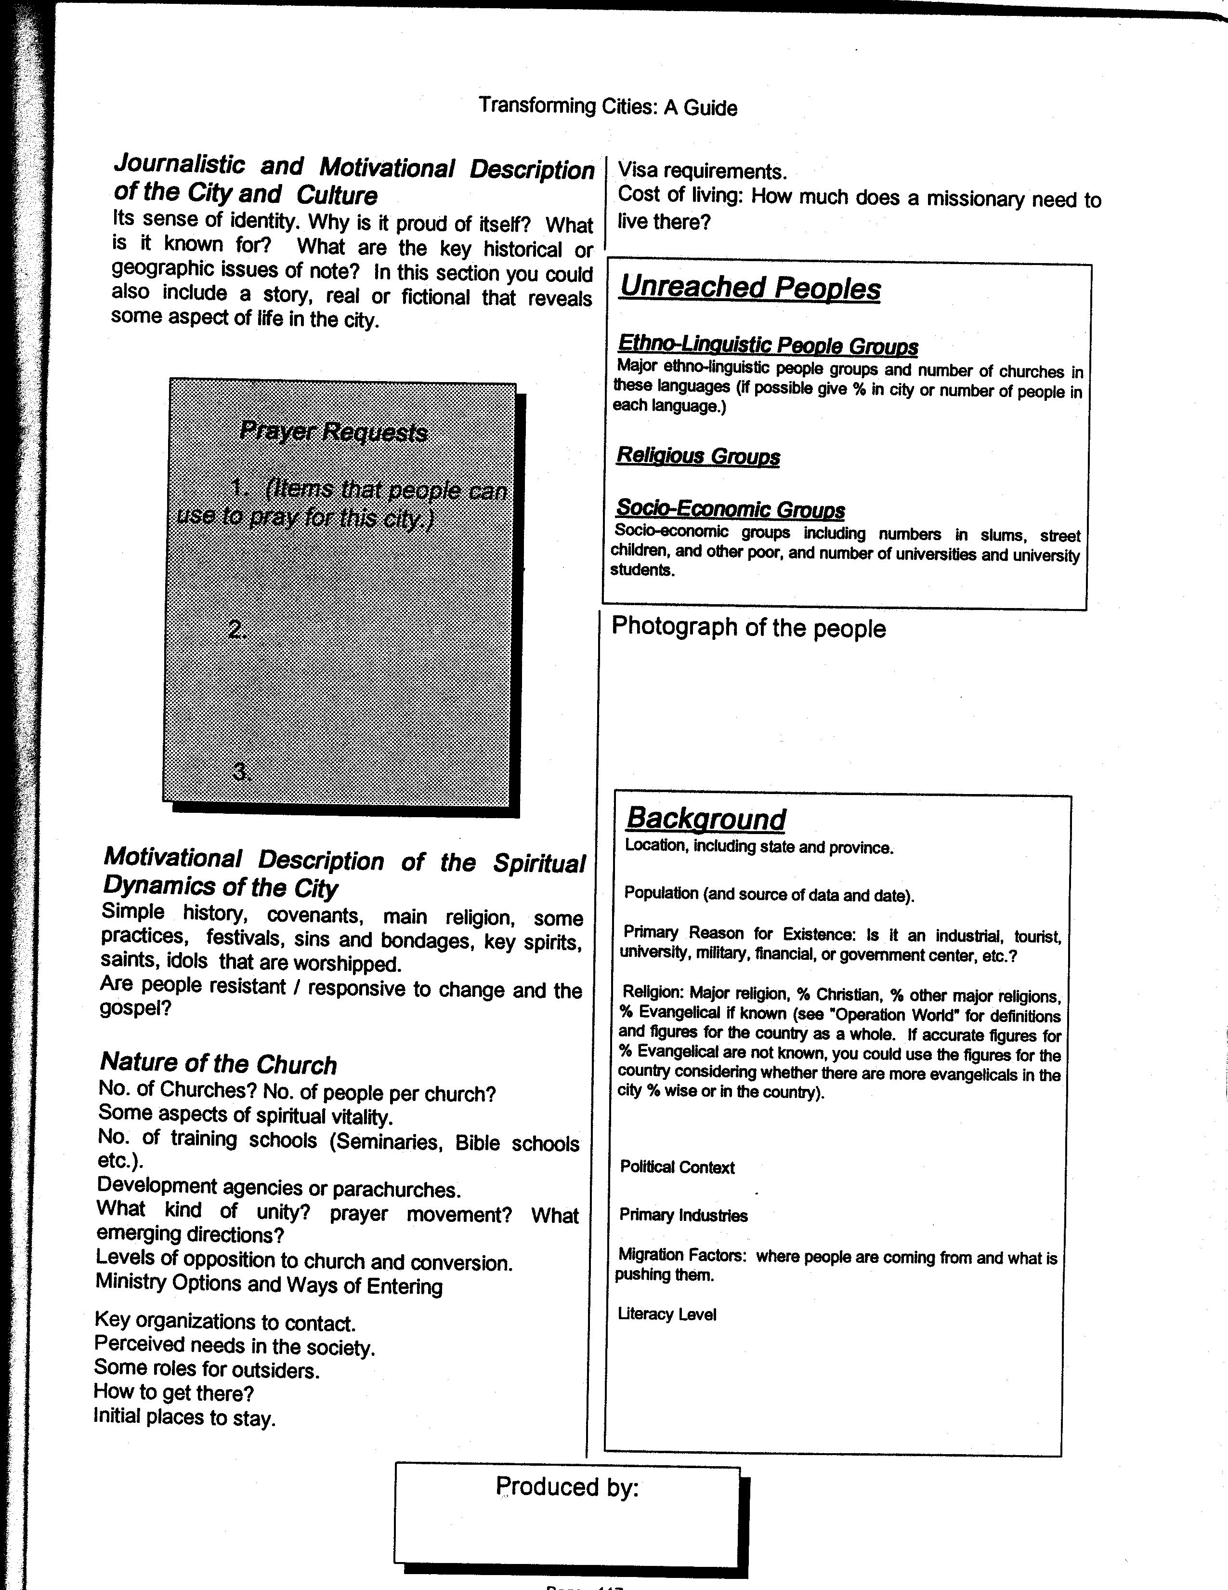
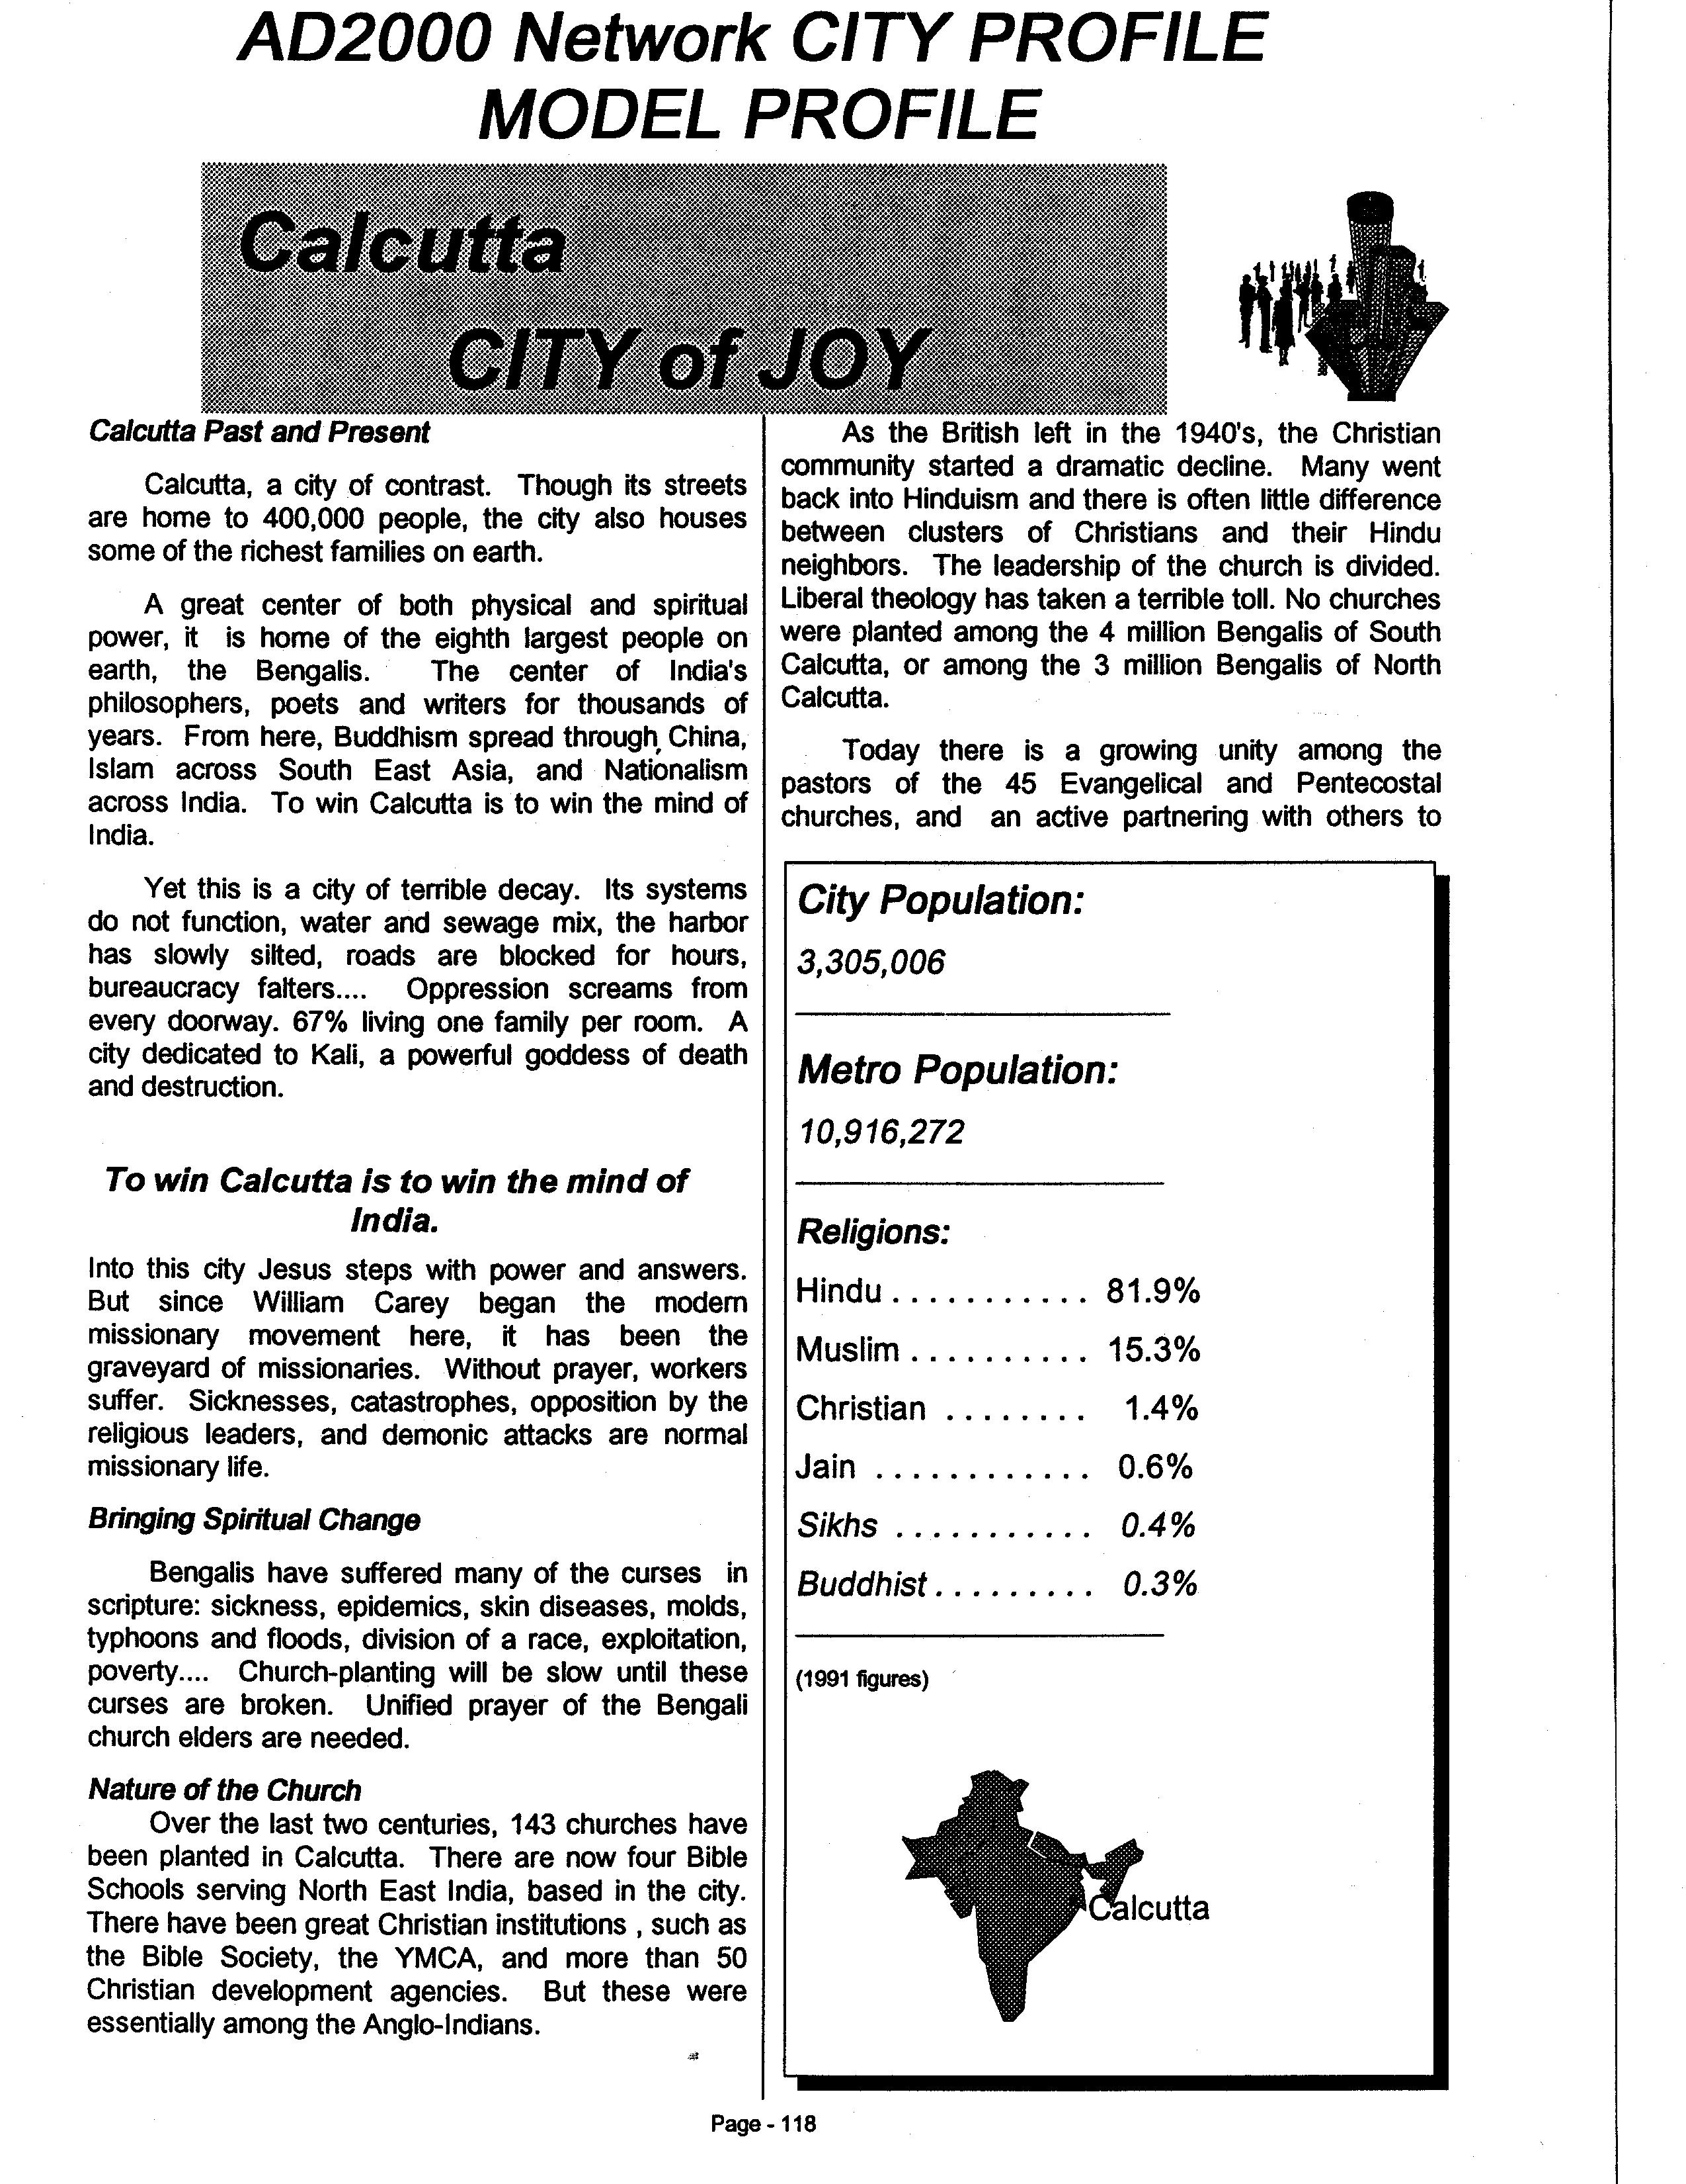

Slide 29
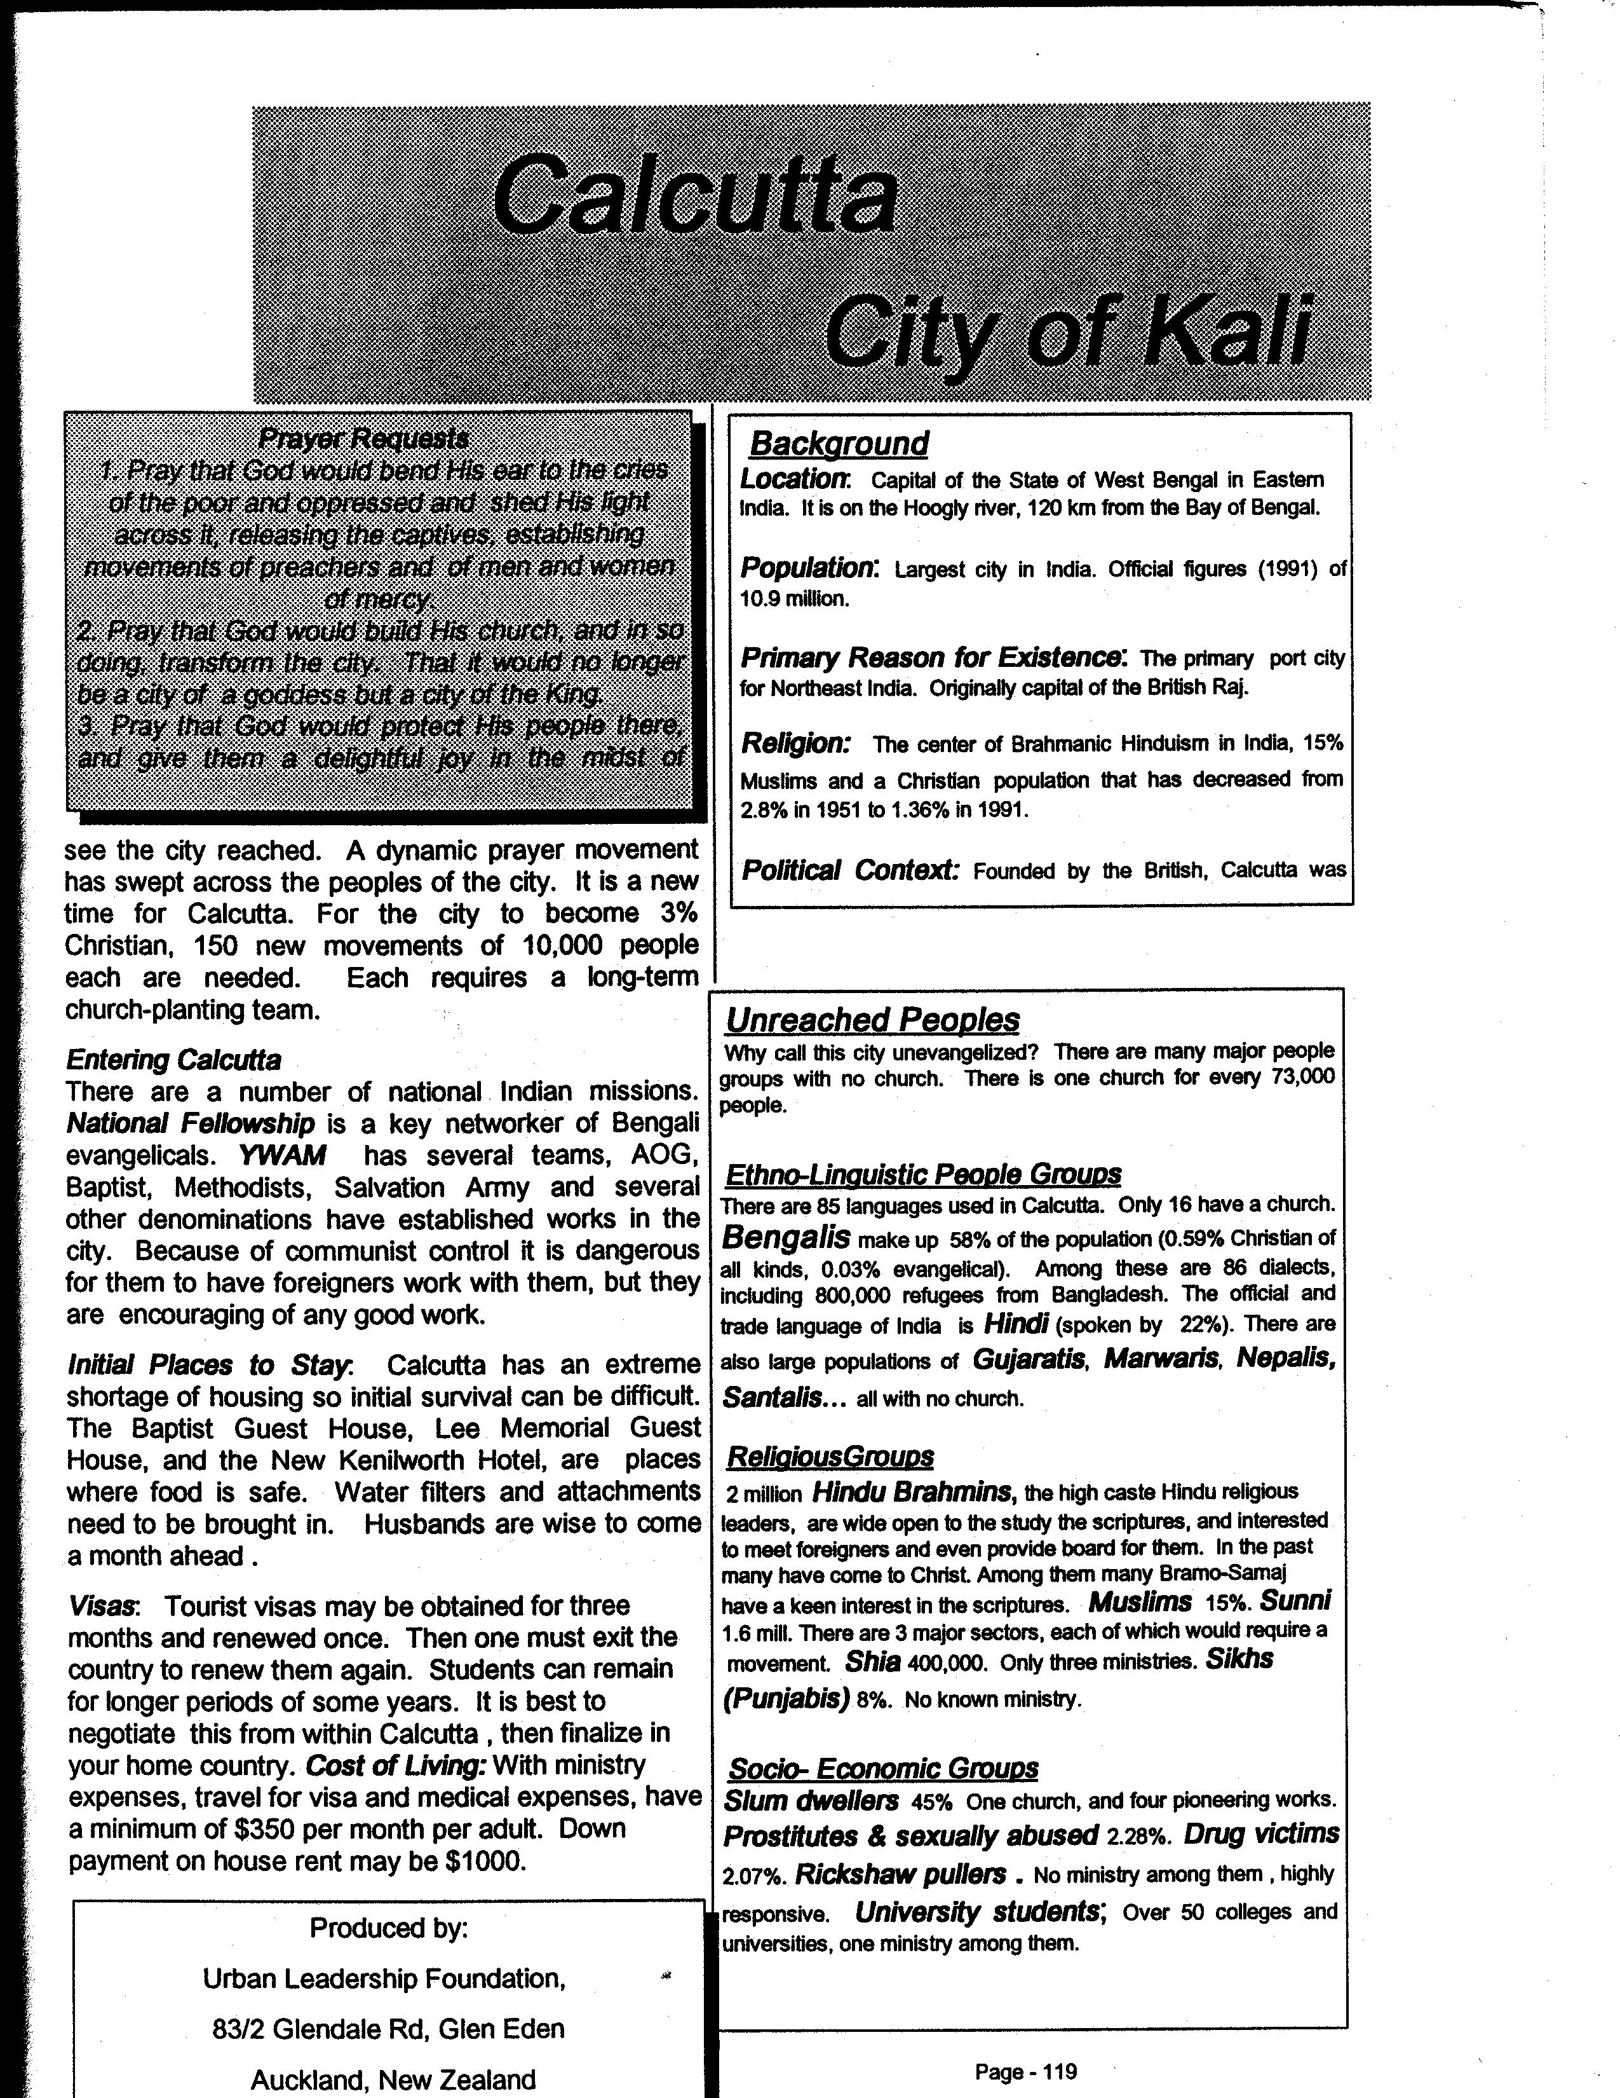

Slide 30
Case Study: 1024 Bangkok Slums: Selecting a Slum
North-Eastern Thai are more responsive. How do we find their poor?
They drive tuk-tuks
Where are there many tuk-tuks parked at night?
Map these.
Which are far from a temple?
Which are big enough so you can reach into five different sectors?
Are any with a building that can be used as a church?
Pornchokchai, (1985). A Thousand Slums in Bangkok. National Housing Authority.

Slide 31
Readings on Missiological Research
Waymire, Bob & Carl Townsend Gathering the Harvest Force Facts. In Discovering Your City Etna C.A.: Light International 2000. pp 5.1-5.6.
MDG Mapping Project
Urban Research for Ministry Strategy (Use Guest, matul2010 to enter).
Barrett, David (1984). Five Eras of Missiological Research. International Review of Missions
Read Grigg, Viv. (2000) Building Blocs. Transforming Cities, Urban Leadership Foundation. Identify each of the aspects of research needed for citywide processes.
Supplementary Readings: People Groups in Cities
Greenway, Roger and Timothy Monsma (1989). "The Intersecting Veins of the City". In Cities: Missions New Frontiers, Baker.
Conn, Harvey. (1991). " Unreached Peoples and the City". Urban Mission, Vol. 8, No. 5, May 1991.

